Slide 1



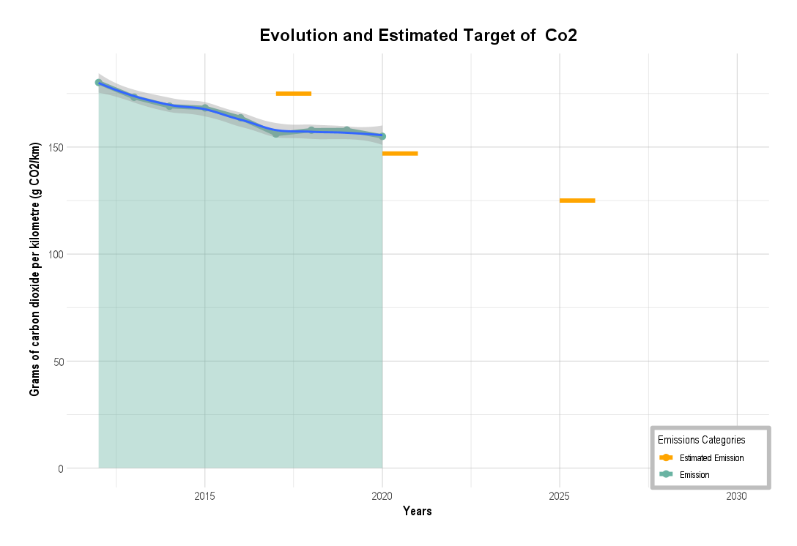
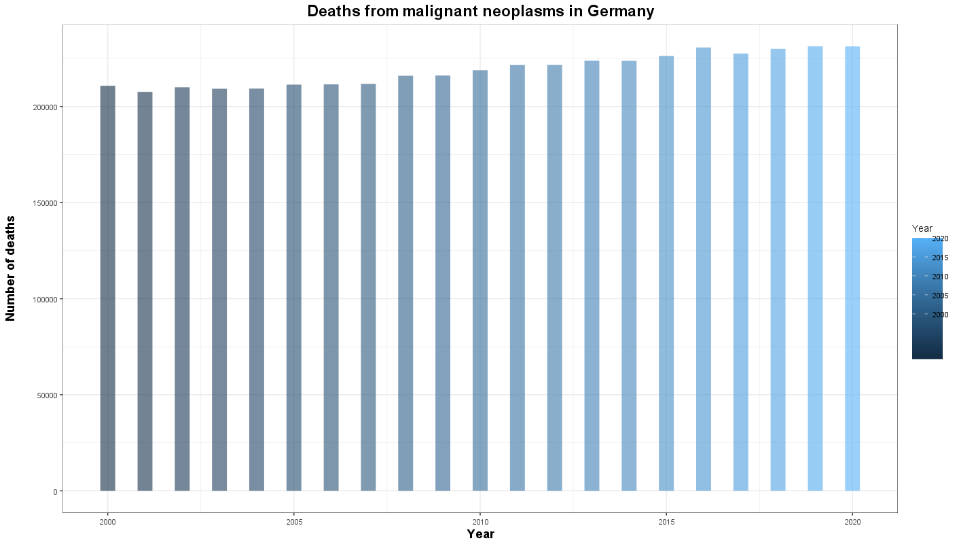
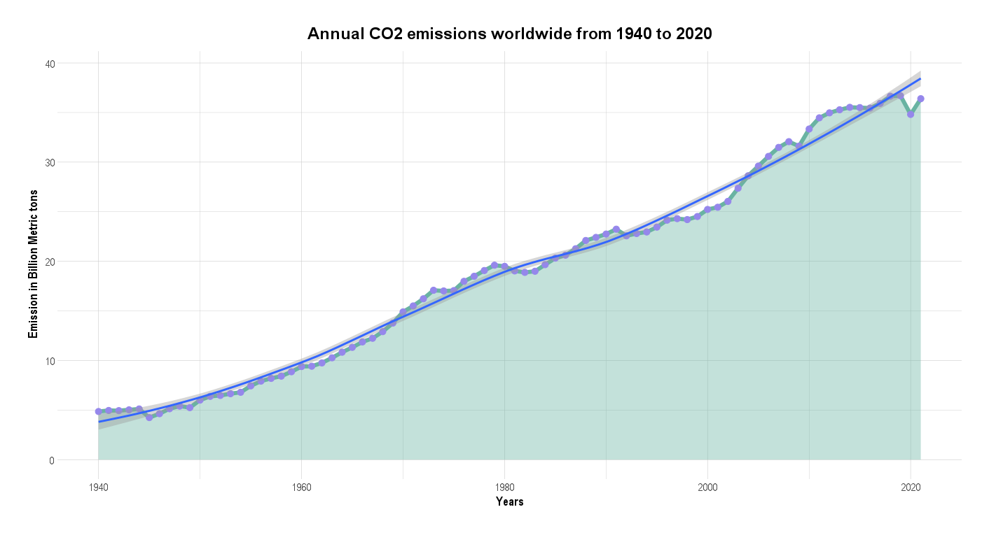
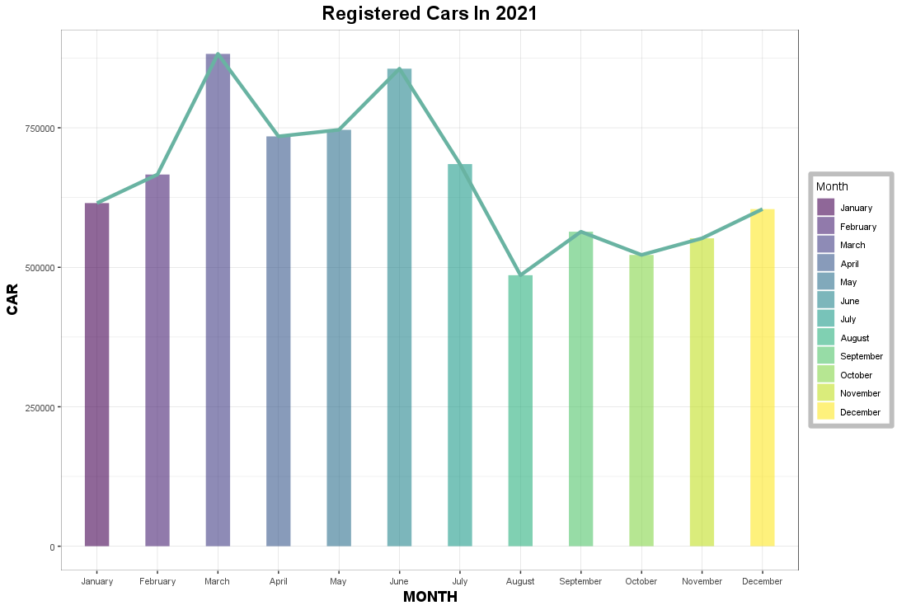
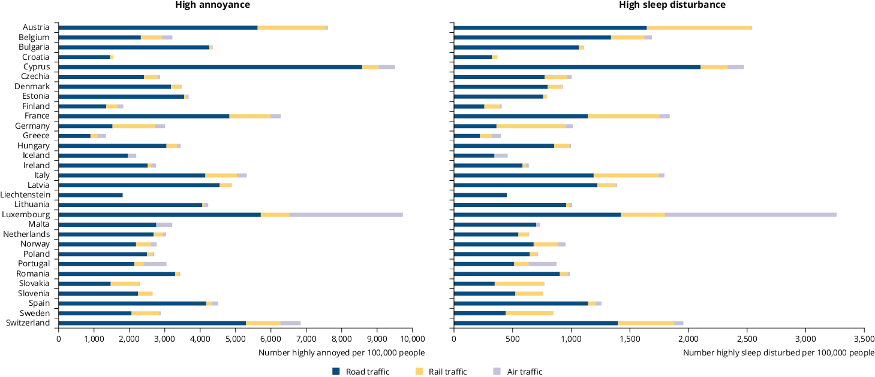

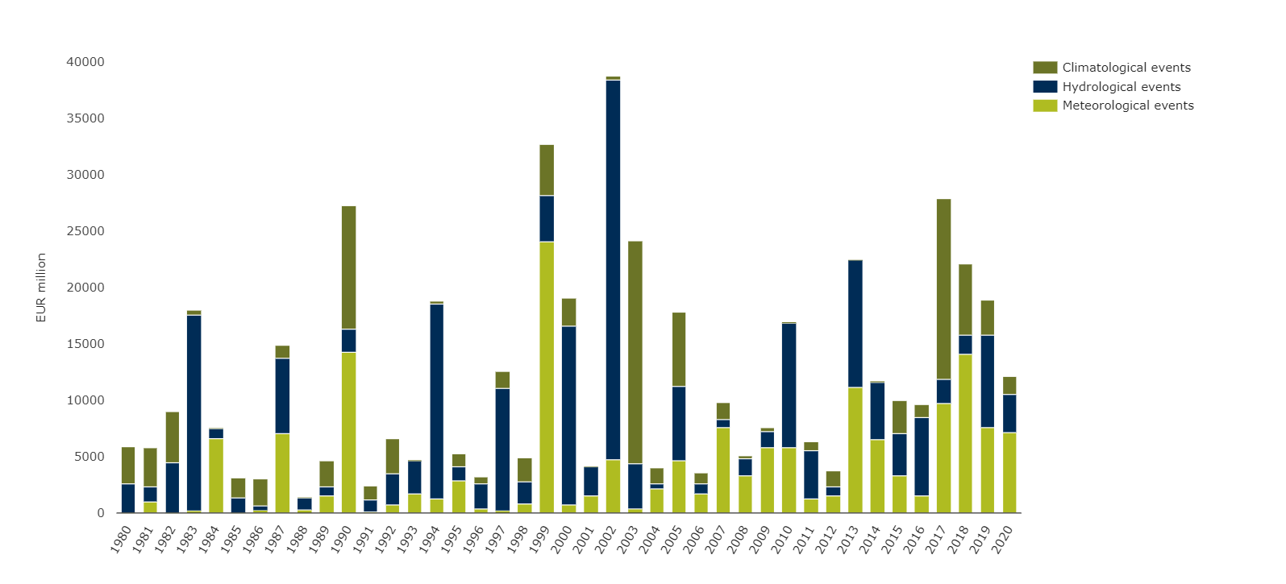
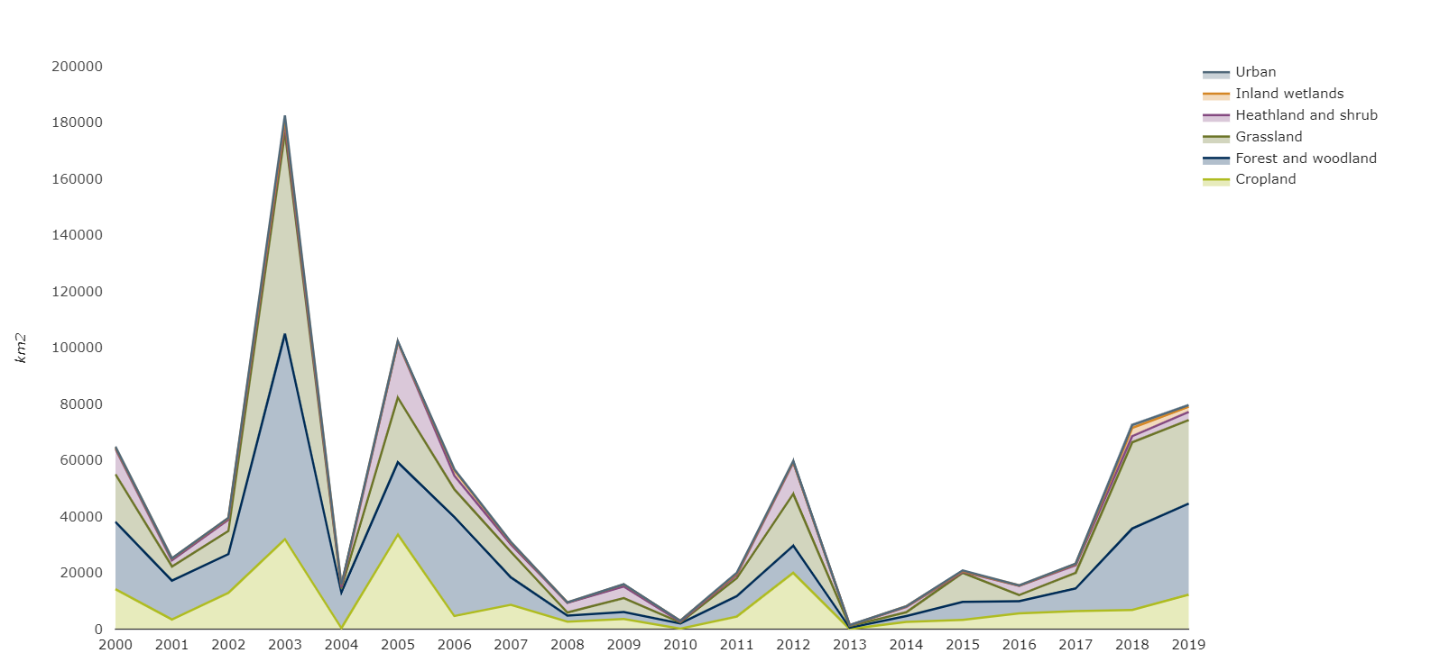
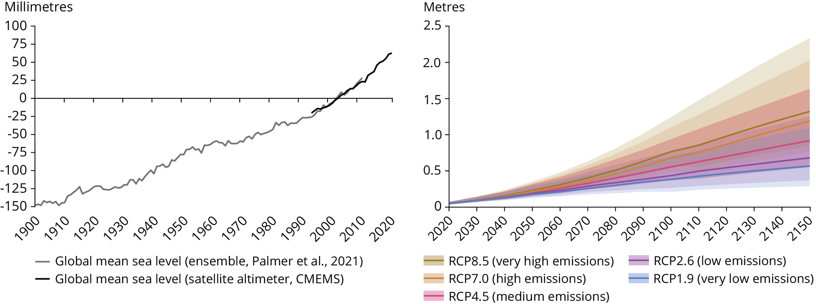
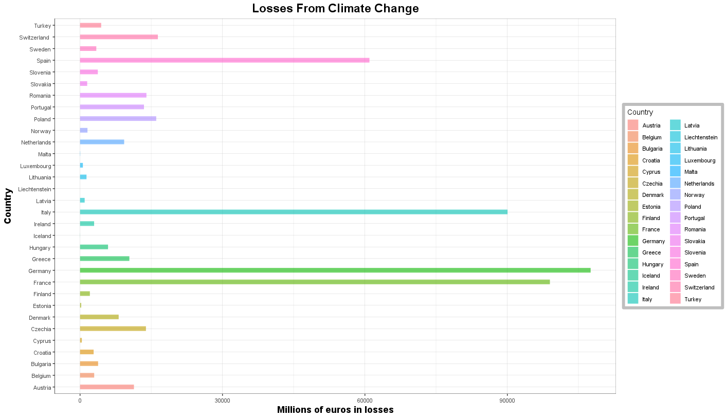


The Effect Of Carbon Dioxide
Emission On The Environment
Overview
Emission and Health
The Regulation (EU) requires Countries to record information for each new passenger car registered in their territory. Each year, each Member State must submit all the information related to their new registrations.
The data are required for the calculation by the Commission of the average specific emissions of CO2 from new passenger cars and for setting the specific emissions targets that shall be met by car manufacturers.
The global emissions of carbon dioxide (CO2) from fossil fuels and industrial activities have risen dramatically in the past two decades, reaching an unprecedented level of 36.7 billion metric tonnes in 2019. This increase in CO2 emissions has a significant impact on the environment and is a major contributor to climate change.
The number of cars registered worldwide is increasing dramatically, especially in the EU.
According to the European Economic Area (EEA), March 2021 is the most important period for car registrations, as it is the breeding season for animals and it is also the time when the snow starts to melt.
Therefore, it will have a huge effect on our health and lifestyle as human beings and a colossal impact on agriculture.
According to the World Health Organization (WHO), the number of deaths due to cancer is projected to increase across the European Union, with Germany being particularly affected due to its high levels of CO2 emissions.
Research conducted by the American Cancer Society has also found that exposure to diesel exhaust, in the form of soot or chemical extracts, can cause changes in the DNA of cells in lab dishes.
While such changes are a necessary factor for cancer to develop, not all substances that cause DNA changes also cause cancer. Studies have shown that prolonged and heavy exposure to diesel exhaust can lead to lung cancer in laboratory animals such as rats.
Road traffic noise is the most prevalent source of environmental noise and contributes the most to the overall effects of noise on health.
A large proportion of people highly annoyed and highly sleep disturbed by transport noise live in urban areas of more than 100,000 inhabitants.
A large share of the population chronically disturbed by noise is exposed to noise levels below 60 dB during the day (L_{den}) and 55 dB during the night (L_{night}).
Economic losses from climate-related extremes in Europe
Engine and Earth
Between 1980 and 2020, climate-related extremes caused economic losses totalling an estimated EUR 487 billion in the EU-27 Member States. Although analysing trends in economic losses is difficult, partly as a result of high variability from year to year, climate-related extremes are becoming more common and, without mitigating action, could result in even greater losses in the coming years.
Annual economic damage caused by weather and climate-related extreme events in the EU Member States
Global mean sea level (GMSL) has risen about 21 cm since 1900, at an accelerating rate. GMSL reached its highest value ever in 2020.
GMSL will likely rise by 0.28-0.55 m under a very low emissions scenario (SSP1-1.9) and 0.63-1.02 m under a very high emissions scenario (SSP5-8.5) by 2100, relative to the 1995-2014 average.
GMSL simulations that include the possibility of fast disintegration of the polar ice sheets project a rise of up to 5m by 2150.
Observed and projected change in global mean sea level
Monitoring the impact of drought is crucial in order to support policies that promote the removal of greenhouse gases and the development of resilient ecosystems that can adapt to the effects of climate change.
Between 2000 and 2019, the EEA-39 region was hit by severe drought, resulting in a significant decline in annual productivity in affected areas, averaging at 3%.
The past decade has seen a particularly high number of drought events, with the years 2013 and 2016-2019 showing a particularly strong impact on vegetation productivity.
Forests were the most affected by drought, with an annual decline in productivity of 5%. This was followed by arable land, which saw a decline of 4% per year, and heathland/shrubs, which saw a decline of 3.1%.
Annual area of drought impact on vegetation productivity (2000-2019)
The economic impact of climate-related extremes varies considerably across countries. In absolute terms, the highest economic losses in the period 1980-2020 were registered in Germany followed by France then Italy.
The EU adaptation strategy aims to promote action at national level, and all countries have already adopted a national adaptation policy. The Climate-ADAPT platform — developed by the European Commission and the EEA — supports action by sharing knowledge on climate change and its impacts, adaptation strategies and plans, and case studies.
Global climate models predict that the rise in global mean sea level (GMSL) during the 21st century will likely be in the range of 0.28-0.55 meters for a very low emissions scenario (SSP1-1.9), 0.44-0.76 meters for an intermediate emissions scenario (SSP2-4.5), and 0.63-1.02 meters for a very high emissions scenario (SSP5-8.5) with a 66% confidence level. However, the future behavior of the Greenland and Antarctic ice sheets remains uncertain, particularly under higher emissions scenarios. Studies that consider the potential collapse of marine-based sectors of the Antarctic ice sheet have estimated a GMSL rise of up to 2.3 meters by 2100 and up to 5.4 meters by 2150.
The inclusion of these high-end scenarios is crucial for long-term coastal risk management, particularly in densely populated coastal zones. Each five-year delay in the peak of global greenhouse gas emissions increases the median sea-level rise projections for 2300 by 0.2 meters and extreme sea-level rise projections (95th percentile) by up to 1 meter.
Prolonged, severe, and frequent droughts can have devastating consequences for ecosystems and the biodiversity they support. These droughts can lead to habitat loss, the displacement of native species, and the proliferation of invasive alien species. Additionally, droughts can have a significant impact on water resources and agricultural production, causing soil erosion, reducing carbon sequestration, and contributing to overall land degradation.
Recent data from the EU-27 and the United Kingdom shows that the frequency and intensity of drought impacts have been increasing over the past decade. The year 2003 saw the largest area affected by drought, but the intensity of vegetation productivity loss was highest in 2002, 2013, and the years 2016-2019.
Over the period of 2000-2019, vegetation productivity loss due to drought amounted to an annual average of 3%. The impacts on forests were the worst, with an annual average productivity loss of 5%. Additionally, croplands experienced an annual average decrease in vegetation productivity of 4%.
References
Notes:
1

